Slide 1

MBAS902: Data Exploration
Chinmay Datar
Student No.: 6956361

Slide 2
Description of the Data
The data name ‘FLACRASH’ is about car crashes that took place in the state of Florida.
The data contains all the important points of the crashes such date, time, injuries and environmental factors and driver’s details.
The data also contains latitudinal and longitudinal coordinates of the districts and counties to get more detailed insights from the data.
The total number of fatalities and injuries are also stored in variables for our convenience
Notes:
The data also contains columns for month of the year, day of the week. Factors affecting the driver and other surrounding factors such as

Slide 3
How to tackle the Problem
There are three answers to three simple questions that we ask every time we hear about an accident.
Where?
When?
How?
So to answer these I have created three dashboards highlighting one aspect of the accident and other factors are given as filters for convenience of the user.
We also create a machine learning model in order to predict the injury in an accident using the given factors.
Notes:
We shall go over all of this one by one.

Slide 4
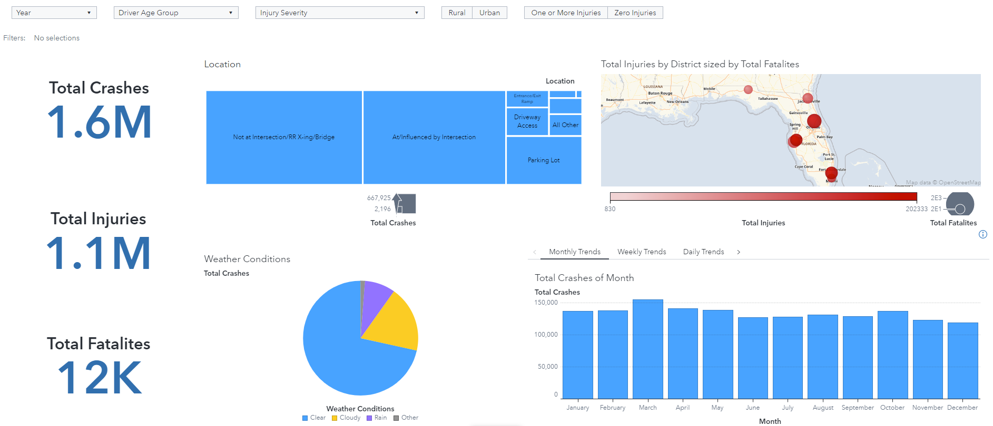
Where did the Crash happen?
Notes:
The above dashboard serves the purpose of answering the first question: ‘Where it happened?’ We shall first look at the map. As can be observed there are high number of injuries and fatalities in West Central, Southeast and Central contributing more than 50% of the crashes, injuries and fatalities. We can dig deeper in the districts by double clicking and see which counties have higher number of crashes. Further we see that almost equal number of crashes occur due to intersection and not at intersection. More than 70% of crashes occur in clear skies. We also notice that more crashes take place in the month of march than any other month but by a small margin. In the stack we can observe we can observe that higher number of crashes happen on Thursdays and in the evening. After filtering driver ages we can see that southwest has more aging drivers that have higher number of fatalities. During Rain Northeast district has higher number of fatalities.

Slide 5
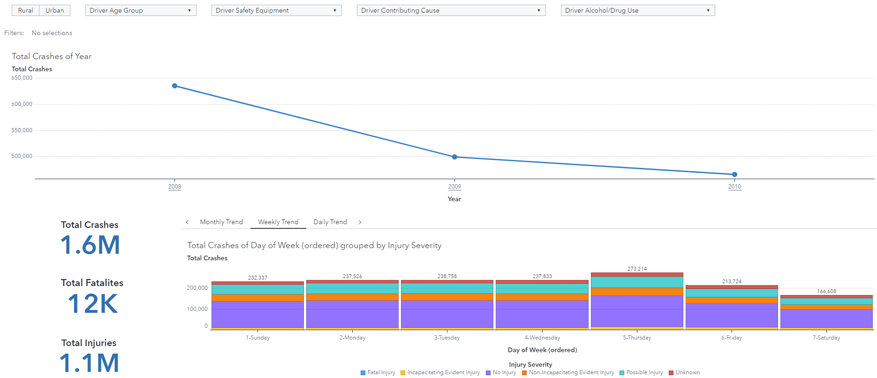
When did the Crash Happen?
Notes:
For the second question ‘when did it happen’ we have one graph which shows total crashes in a year. We can further drill down in year, month and date to see the number of accidents happening at any one point of day in the given time frame. The stack shows trends monthly, weekly and daily trends grouped by injury severity. As can be observed more than half the crashes don’t result in any injury and around 25% of result in possible in injury or non-incapacitating injury. Month of March records highest number of accidents in every year while Thursdays have highest number of crashes in a week. When drivers driver over the safe speed limit or disregard the traffic rules the injury severity increases which can be seen from the graph after filtering. Another thing to note is if the driver is under any kind of influence alcohol or drugs the chances of incapacitating injuries significantly increases. Most drivers are under the influence of alcohol or drugs or both on Thursdays Fridays and Saturdays and only in the night leading to more non-incapacitating and fatal injuries.

Slide 6
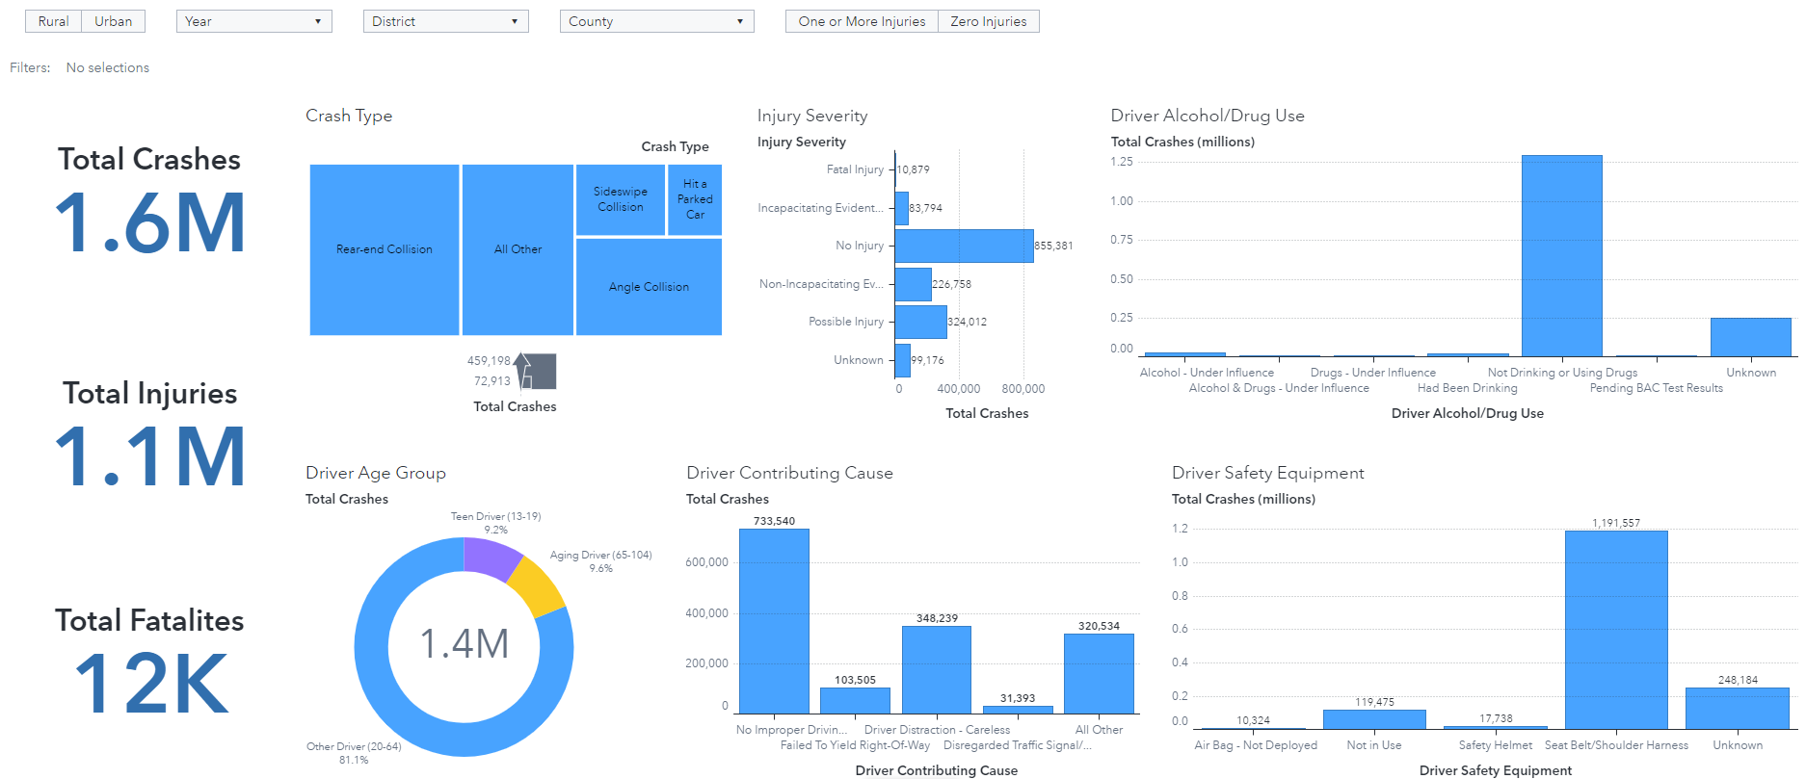
How did the Crash Happen?
Notes:
For the third question we will see what conditions was the driver driving in. From the graphs we see that in most crashes the driver has seatbelt on, not under influence of alcohol or drugs, is properly driving. These stats make sense as even though the crash took place but in more than 50% of the cases there are no injuries as can be seen in injury severity graph. We can also see that crash type does not have a pattern to it. Although the most common type of crash is Rear end collision which in most scenarios is not severe and could lead to only minor injuries. If we click on rear end collision we will see the most severe injury is non-incapacitating in 90% of the crashes. Another insight from this dashboard is teen drivers are generally very distracted and is the highest contributing cause and is some cases safety equipment is not in use. Driver distraction is also the biggest cause of crashes in all age categories.

Slide 7
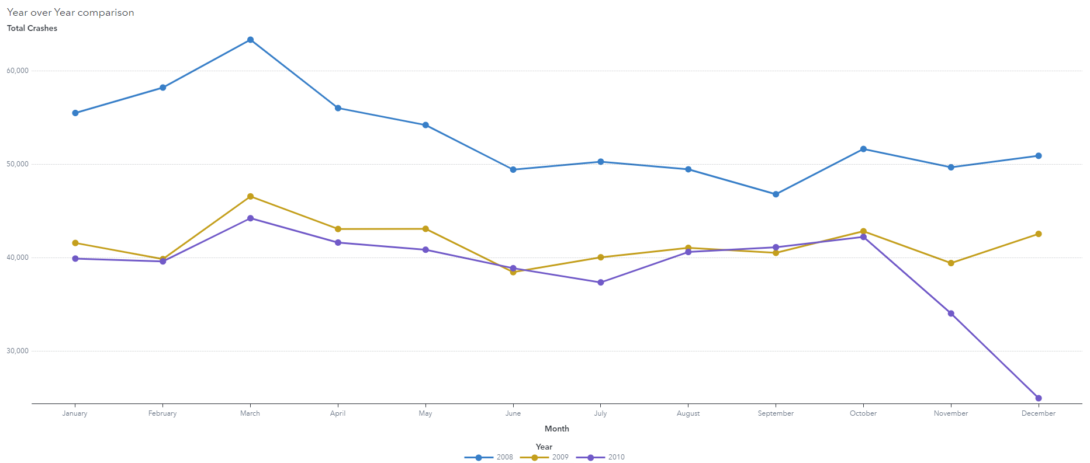
Year to Year comparison
Notes:
To get a clearer a picture of total crashes in a year we visualise crashes in every year with a lien graph. As noted before the month of March has the highest number of crashes in the year. But the number of crashes has significantly reduced from 2008 to 2009. From 2009 to 2010 the crashes have further reduced but no by significant margin. Although in the month of November and December of 2010 the crashes have gone down from 42K to only 25K. This shows the that road safety and awareness is increasing every year in the state of florida.

Slide 8
Decision Tree Model
To be able to predict crashes in advance we use all the variables discussed before to build a decision tree model.
We create a new category called Crash injury which will have 2 categories: Zero injuries, one or more injuries.
We use this new variable as our target variable for the decision tree.

Slide 9
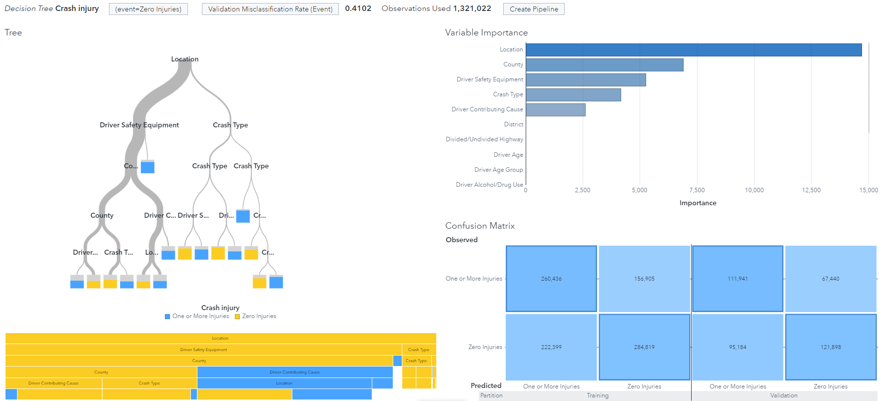
Notes:
After making the Decision tree we see the misclassification rate is 0.4079 which is quite low. The most important variable according to the model is location followed by county. As seen in confusion matrix we can conclude that the model predicts zero injuries more accurately than one or more injuries. To increase accuracy of this model we could interactive effects or create a logistic regression model which could be better suited for this task. The cut-off value for the this model is 0.55 which means above that there is guaranteed injury.

Slide 10
Thank You

